Slide 1
Smart Battery Monitor
A Project Presented for Fulfillment
For Diploma Project in Computer Science
Submitted by
Mohamed Sayed Hemed El-Sayed
Sherif Mostafa Samy Ahmed
Supervised by
Dr. Ahmed Hamza
Cairo, Egypt
July 2021

Slide 2
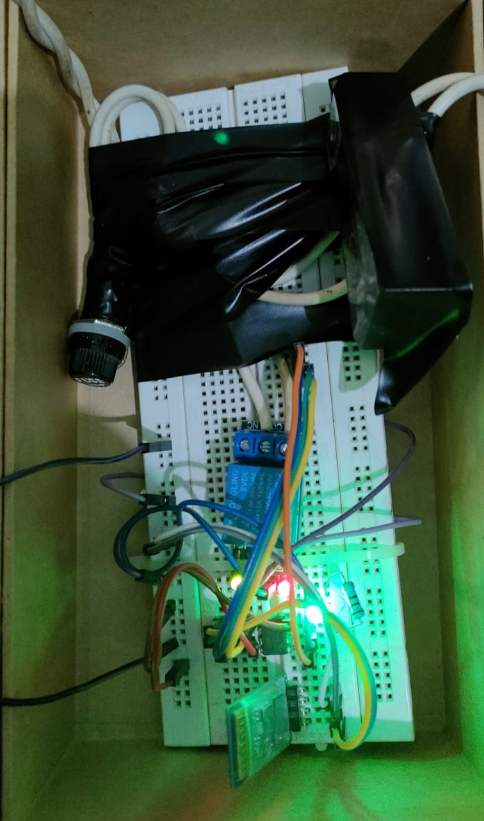
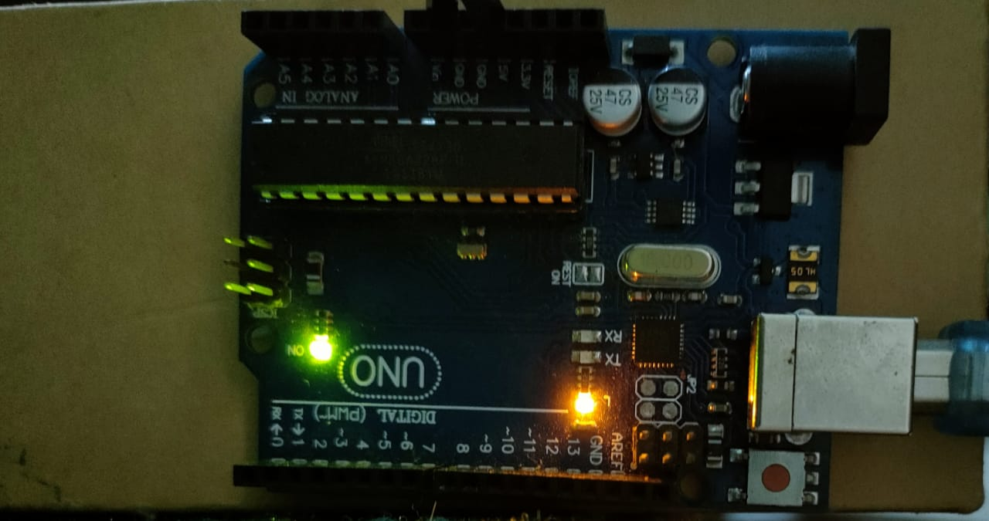
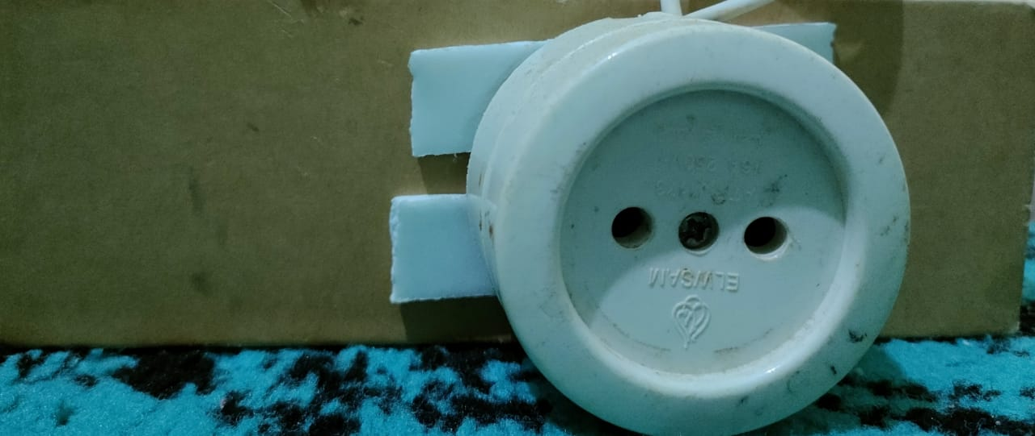
Introduction
This project is an embedded system portable device that automate the process of charging/discharging laptop charger for the sake of increasing lifetime of the battery.
It’s an integration process between software and hardware to reach the goal of designing this product.

Slide 3
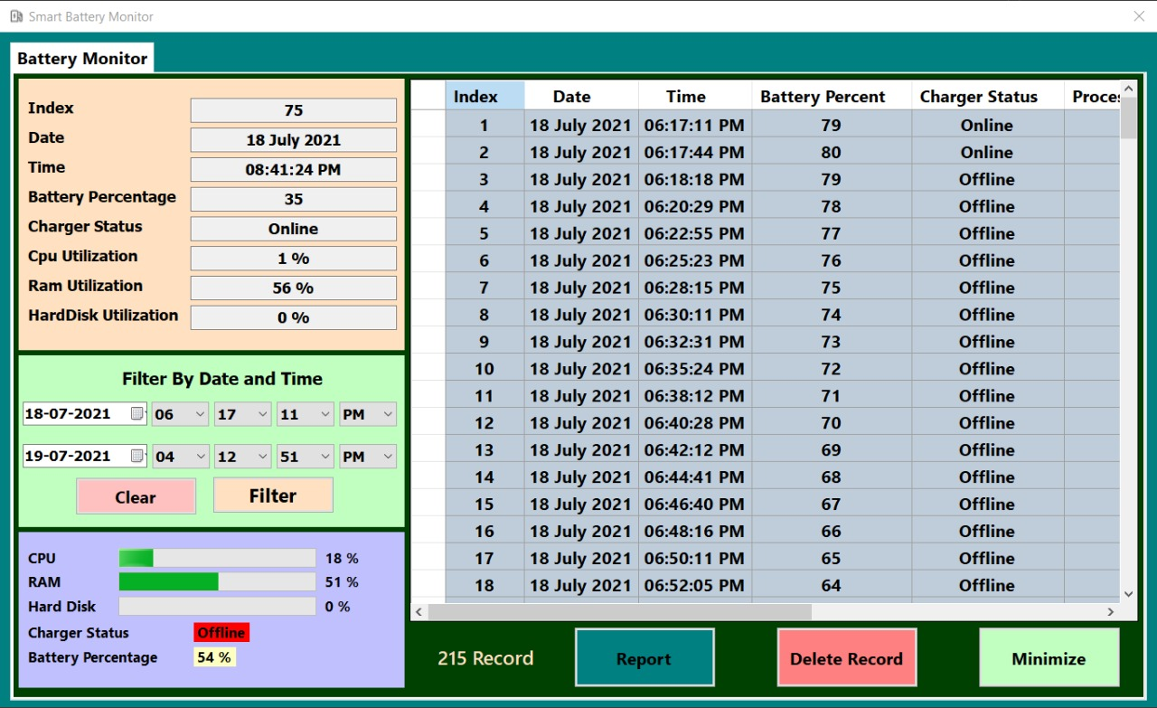
Software background application
The development of this product is divided into two main parts :
First : a background application that written in C# has the following functions :
1- Connect the embedded Bluetooth module in the laptop with our device.
2- View battery status at the run time
within an interval according to the user desire.
3- Analyze the battery performance with numbers and statistics
in a log file with a specific interval
which the user could determine.

Slide 4
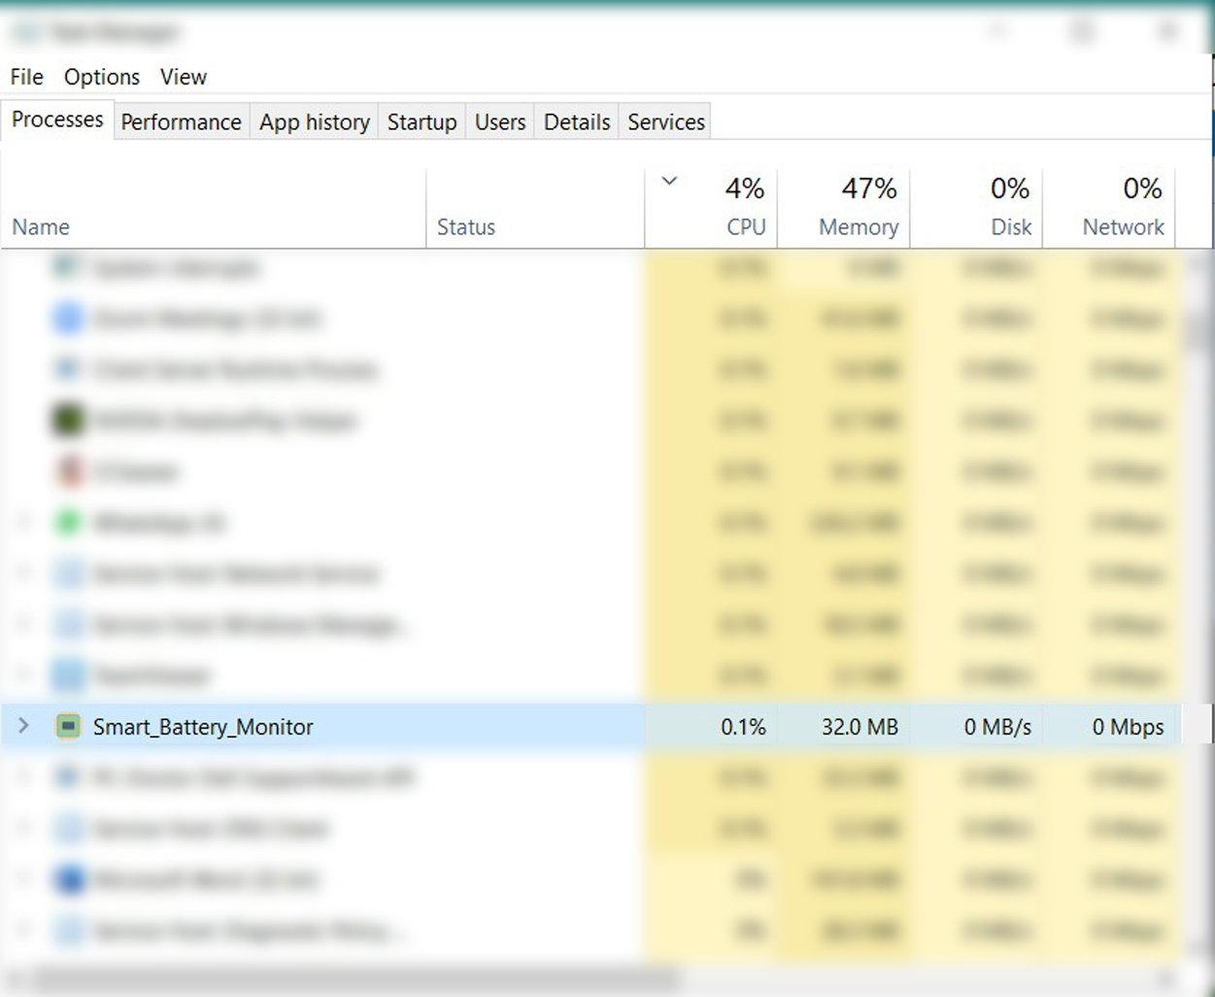
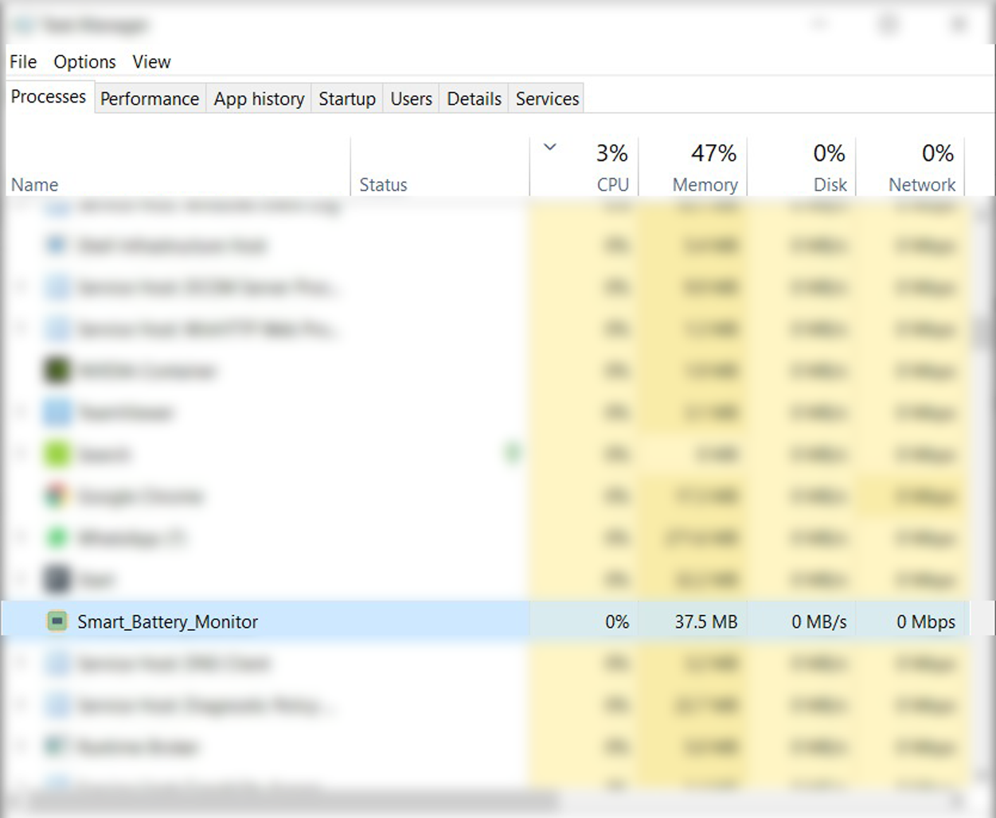
Foreground vs background performance

Slide 5
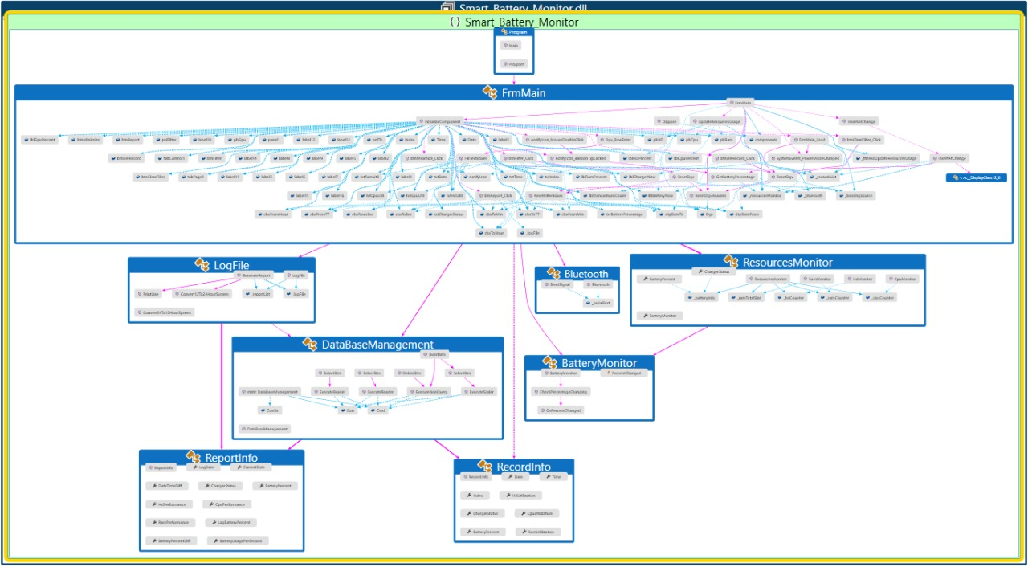
Software Code Map
Because we use OOP and Functional programming paradigms the best diagram to describe this code is the code map it’s looks like a tree.

Slide 6
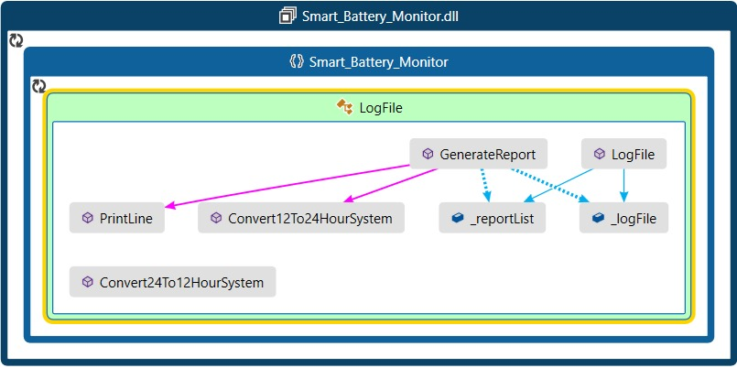
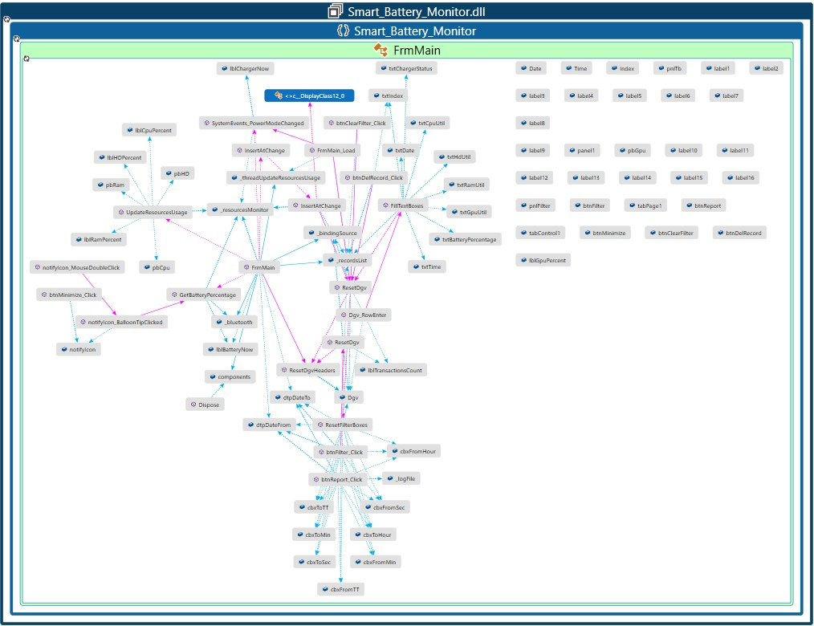
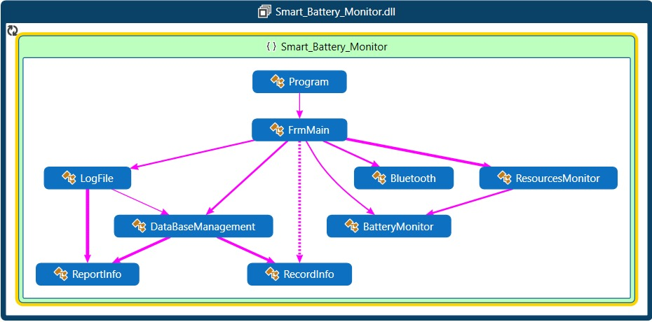
Software Code map cont …

Slide 7
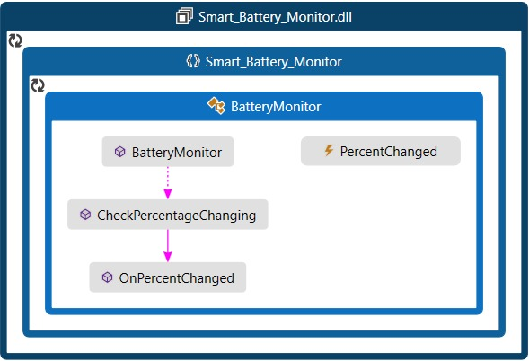
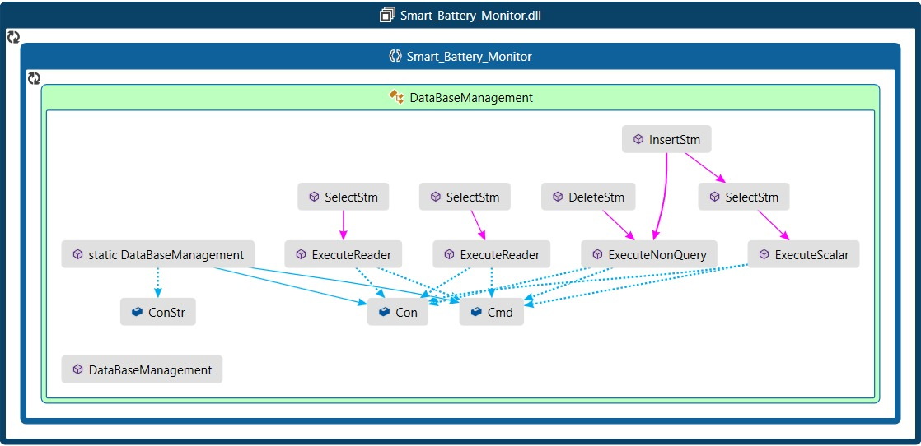
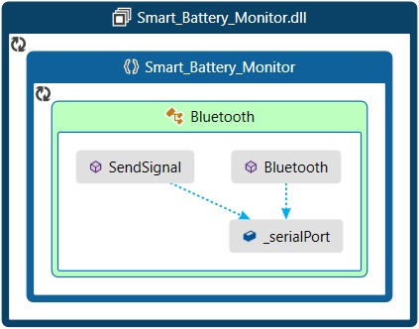
Software map cont …

Slide 8
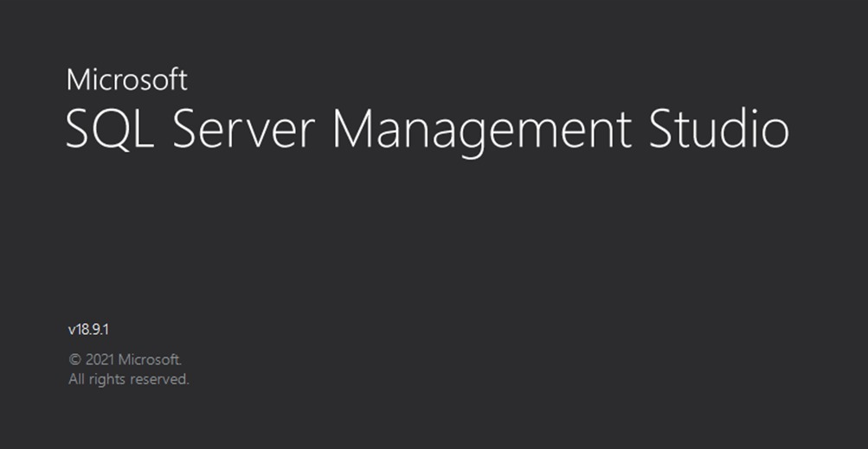

Technologies used in the Software
SQL Server management studio to write queries and interact with database.

Slide 9



Technologies used in the Software cont…
Visual studio : The best IDE to
write and debug native and cross
platform C# application.
C# 9.0 : The latest version of C# language.
Dot net framework 5.0

Slide 10

Technologies used in the Software cont…
ReSharper is a renowned productivity tool that turns Microsoft Visual Studio into a much better IDE.
NET developers and teams rely on ReSharper to write and maintain code in a more manageable and enjoyable way, adopt the best coding practices, and deliver higher quality applications faster

Slide 11
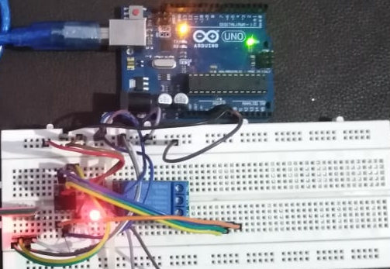
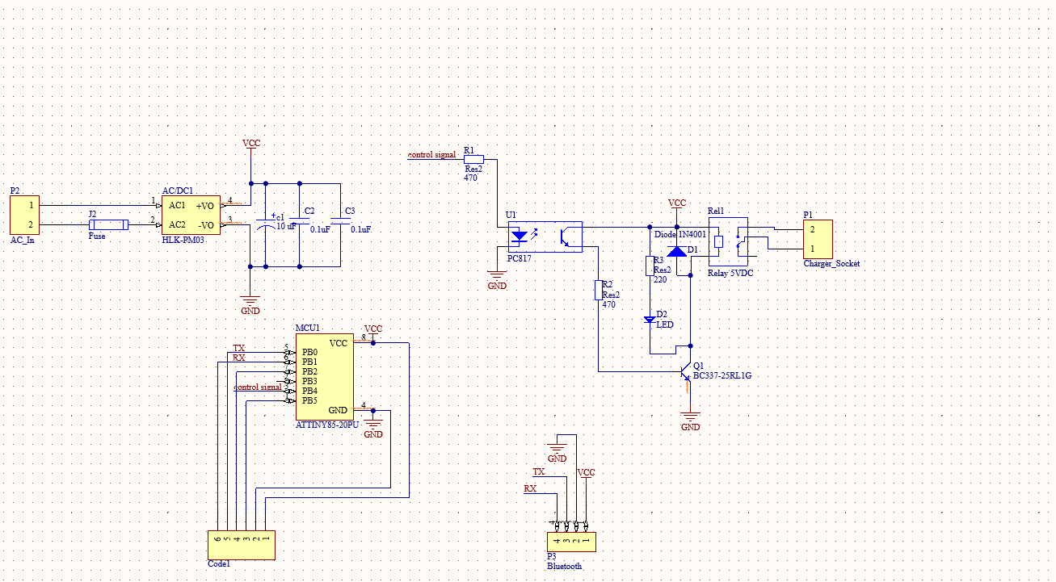
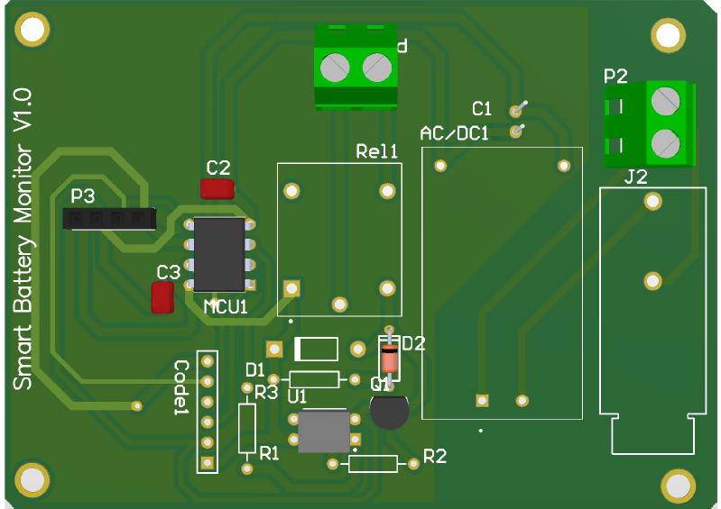
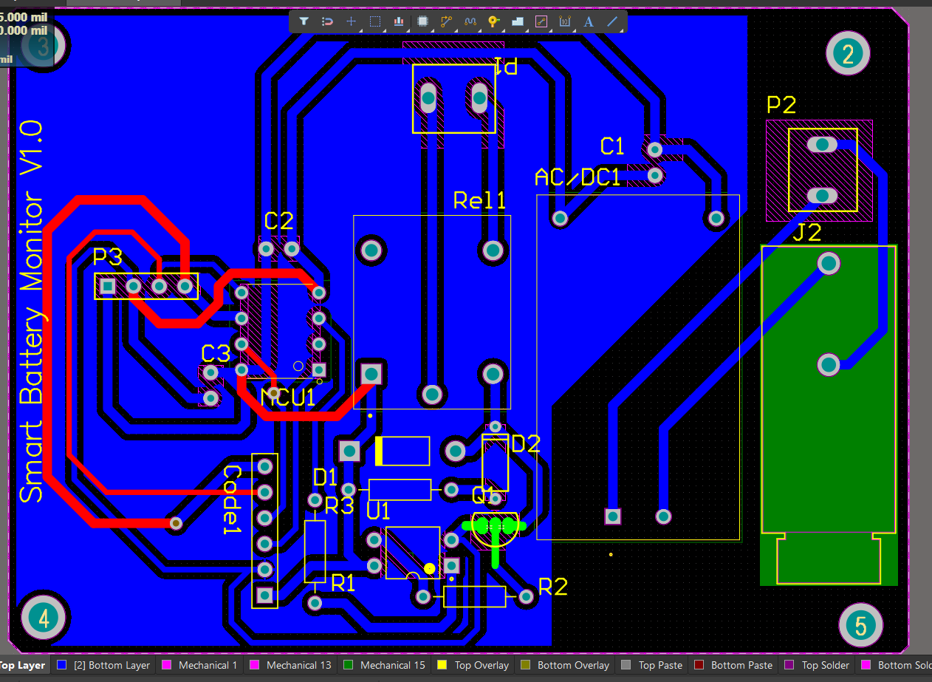
Hardware
The hardware Itself is divided into two parts :
1- The circuit, to design it you must pass these stages:
A prototype using breadboard
b) A schematic design
c) A PCB : the last stage in which the
product is converted from
prototype into real handheld product.

Slide 12
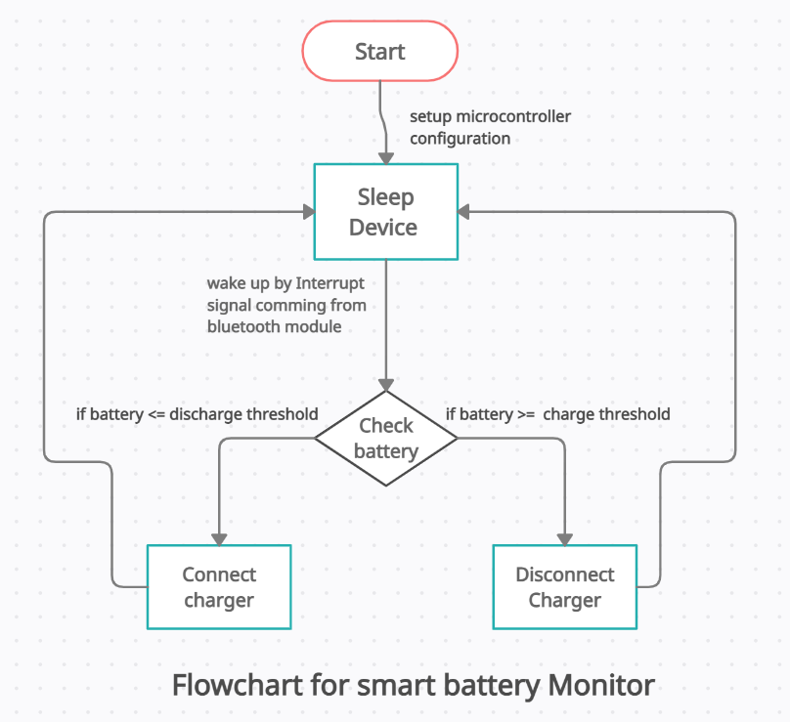
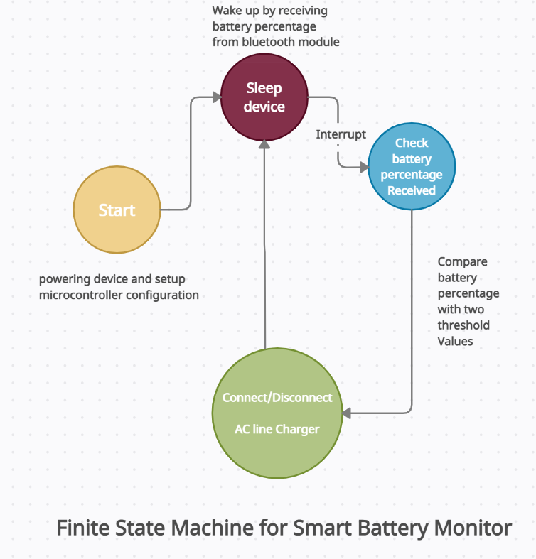
Hardware cont…
2- The code which burn on the microcontroller :
This code is written in C-language it has the following functions :
Communicate with Bluetooth module.
Go to sleep mode to save power.
Check battery percentage,
if it’s <= discharge threshold connect the charger
Else if >= charge threshold
disconnect the charger

Slide 13
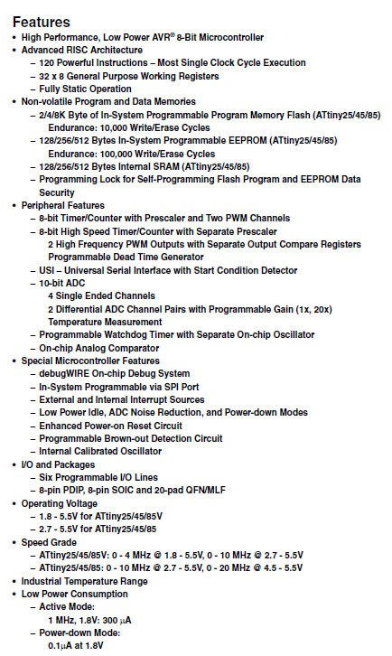
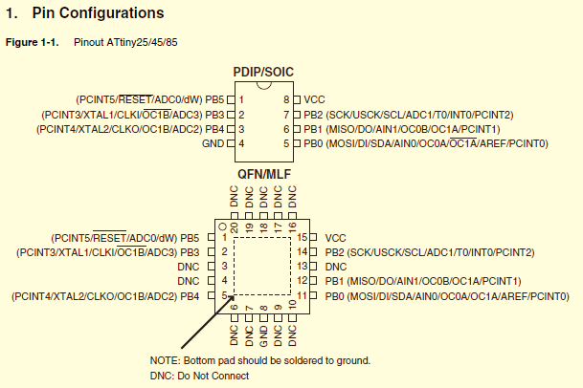
Criteria for choosing uC:
We must take care when we choose uC in :
1-Space : Maximum size of program memory .
2-Power: The Power consumption is one of
the most important issues as in according to this
issue we then we choose the
appropriate battery which fit our system
3-Price : if the price of uC is expensive it led
to make the whole system expensive as well .
So as Embedded system Developer we
must be careful of these Constrains.
After a lot of research, we find that
the best microcontroller that
fit our application is Attiny85.

Slide 14
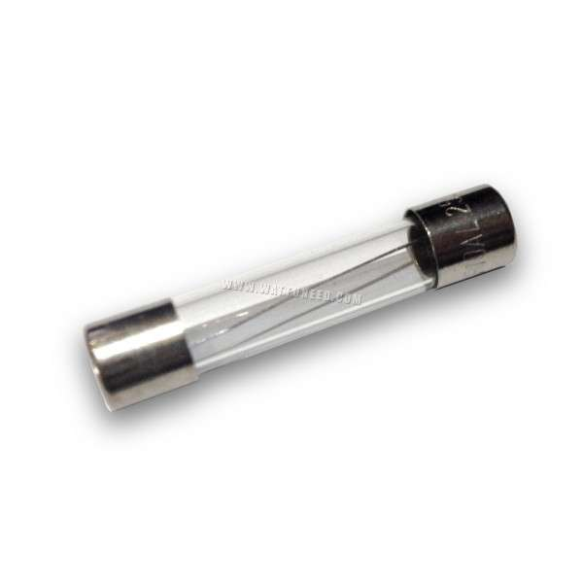
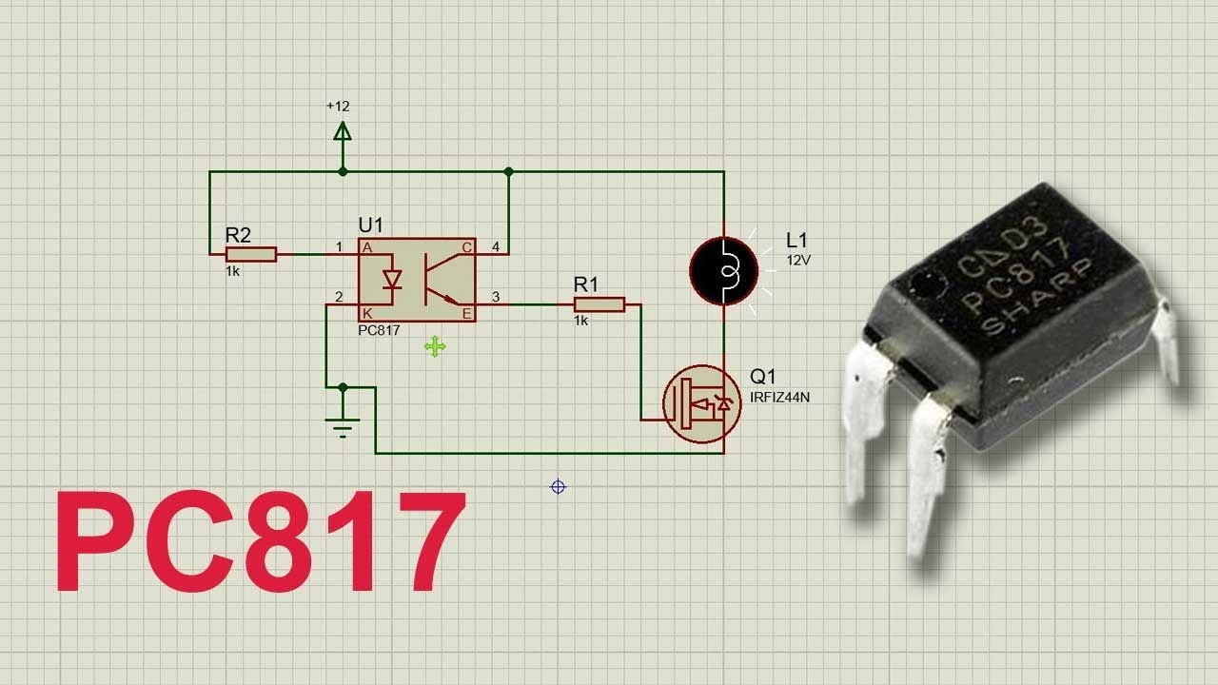
Protection and isolation of uC
As we deal with AC 220 High voltage, and our uC microcontroller we must first put a fuse to protect our circuit from damage then we used an opto-transistor to give the relay 5dc volts to connect the charger indirectly via the light embedded inside an IC which called pc817

Slide 15
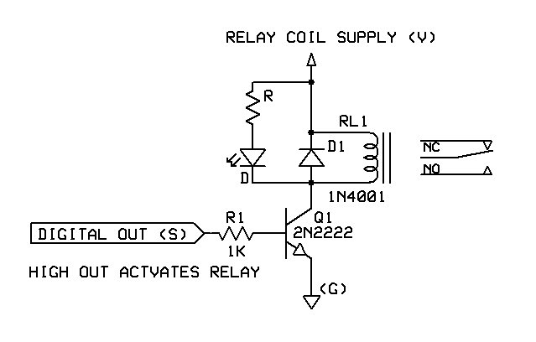
How have we overcome EMF ?
Thermal Electromotive Force (EMF) is generated when the dissimilar metals that make up terminals, contact springs, and contact's touch. This electromotive force, measured in micro volts, could be very small or large, and can create undesirable noise during electrical measurements.

Slide 16
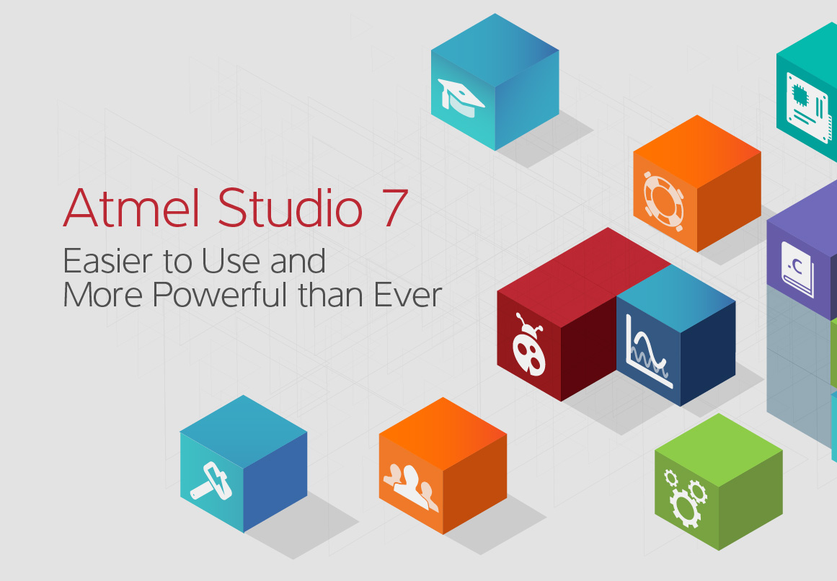
Technologies used in the hardware
Atmel Studio : this is the best ide to write the code into AVR microcontroller type.

Slide 17
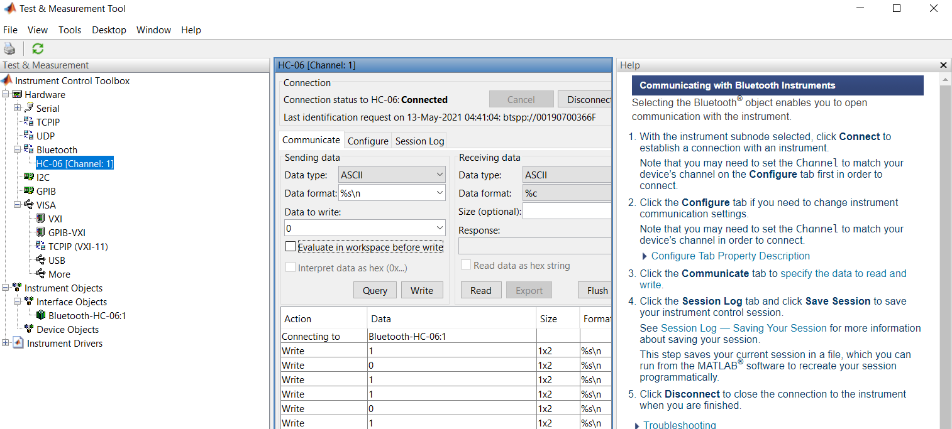
Technologies used in the hardware cont…
Using MATLAB tmc tool to configure Bluetooth :

Slide 18
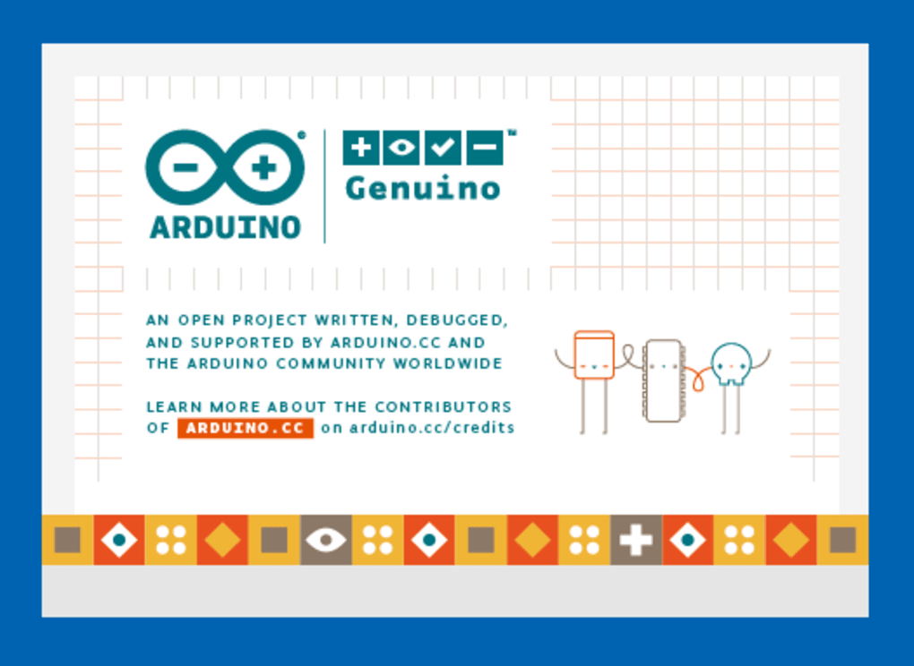
Technologies used in the hardware cont…
Arduino IDE : we use this Ide to upload and burn
The code into the microcontroller
Via programmer board called
Arduino as ISP

Slide 19

Technologies used in the hardware cont…
Altium designer : we use this
great program to make the
schematic design and PCB files
Which we could send it to
The manufacture to make a real Board.

Slide 20
Thanks
We couldn’t express our feeling towards Dr\Hamza with words so we promise if this product became real, you are the first one who will use this product to make your laptop battery life longer and support more and more students.

